Slide 1
JAISINGH S CSE, Third year 210921104022
Handwritten Digit Recognition using Generative Adversarial Network
3/21/2024 Annual Review

Slide 2

AGENDA
Generative Adversarial Network
Objective
Real time application
Generator and discriminator
Problem Statement Proposed System/Solution
System Development Approach
Algorithm and Deployment
Result
Conclusion
References
3/21/2024 Annual Review

Slide 3
Generative Adversarial Network
A Generative Adversarial Network (GAN) is a class of machine learning frameworks introduced by Ian Goodfellow and his colleagues in 2014.
GANs are composed of two neural networks, a generator and a discriminator, which are trained simultaneously through adversarial training.
GANs have been used for a variety of applications, including image generation, style transfer, super-resolution, and more.
3/21/2024 Annual Review

Slide 4
PROBLEM STATEMENT
"Inefficient handwritten text recognition persists due to the scarcity of diverse datasets and the complexity of individual writing styles. To address this, leveraging Generative Adversarial Networks (GANs) offers a promising avenue. Our project aims to harness GANs to generate realistic handwritten characters, facilitating data augmentation for improved model training. By bridging the gap between synthetic and real-world handwritten samples, our approach seeks to enhance the accuracy and robustness of handwritten text recognition systems. Through this research, we aim to revolutionize handwritten text processing, enabling more efficient and accurate recognition across various applications and industries."
3/21/2024 Annual Review

Slide 5
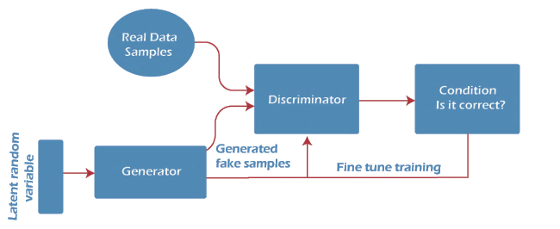
PROJECT OVERVIEW
3/21/2024 Annual Review

Slide 6

WHO ARE THE END USERS?
Researchers and Developers: They may use the GAN-based system to develop and improve algorithms for handwritten digit recognition.
Software Developers: They may integrate the GAN-based system into applications or software that require handwritten digit recognition, such as OCR (Optical Character Recognition) software.
Businesses: They may use the GAN-based system for tasks such as digitizing handwritten documents or recognizing handwritten digits in forms for data entry.
Individuals: They may use applications or services that utilize the GAN-based system for tasks like digitizing handwritten notes or recognizing handwritten digits in personal documents .
3/21/2024 Annual Review

Slide 7
SOLUTION AND ITS VALUE PROPOSITION
Improved Accuracy: GANs can improve the accuracy of handwritten digit recognition compared to traditional methods by generating more realistic and diverse training data, which helps the model generalize better to unseen examples.
Data Augmentation: GANs can be used to augment the training dataset with synthetic examples, reducing the need for large annotated datasets and potentially improving the model's performance, especially in scenarios with limited data.
Robustness to Variability: GANs can help the model become more robust to variability in handwriting styles, strokes, and other factors that may affect the appearance of digits, leading to better generalization performance.
Reduced Manual Annotation: By generating synthetic data, GANs can reduce the manual effort required for annotating large datasets, making the training process more efficient and cost-effective.
3/21/2024 Annual Review

Slide 8
SOLUTION
Handwritten Digit Recognition using Generative Adversarial Networks (GANs) involves training a GAN consisting of a generator and a discriminator. The generator creates realistic handwritten digit images from random noise. The discriminator distinguishes between real digit images and those generated by the generator. The GAN is trained in an adversarial manner, where the generator aims to fool the discriminator by generating realistic digits, and the discriminator aims to correctly classify real and generated digits. Once trained, the discriminator can be used as a feature extractor, and its features are fed into a classifier for digit recognition. This approach leverages GANs to generate synthetic data, which can improve the performance of the classifier, especially in scenarios with limited training data.
3/21/2024 Annual Review
8

Slide 9
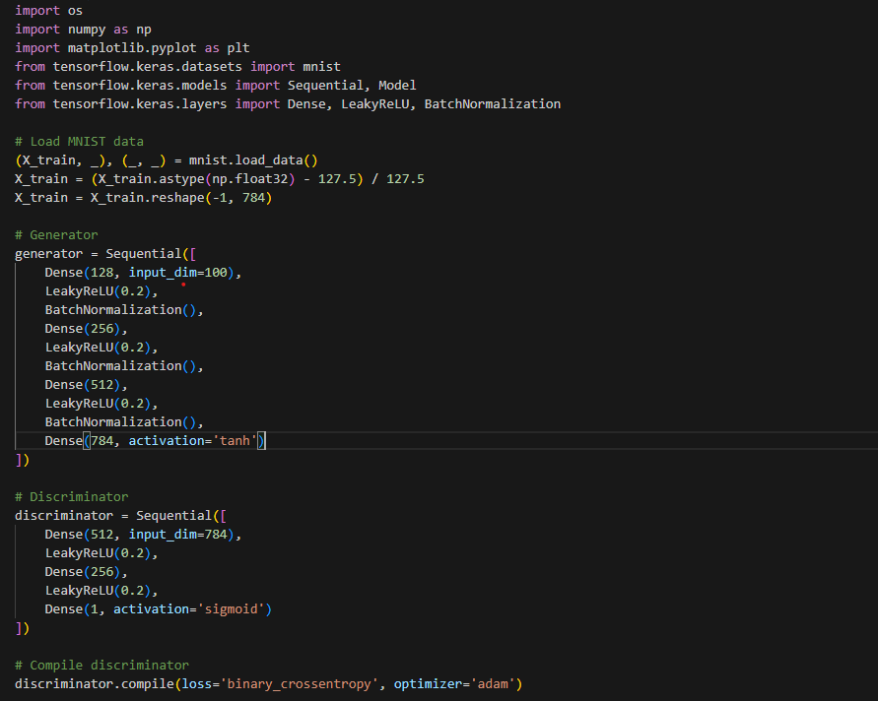
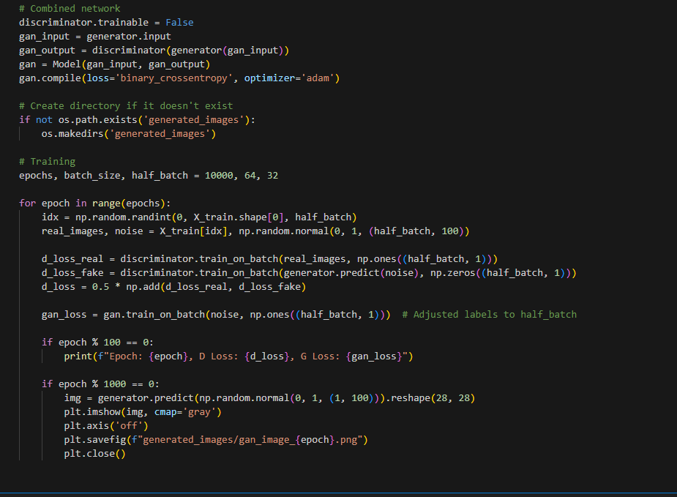
MODELLING
3/21/2024 Annual Review
9

Slide 10
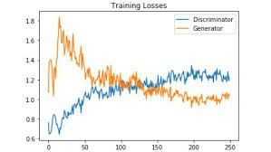
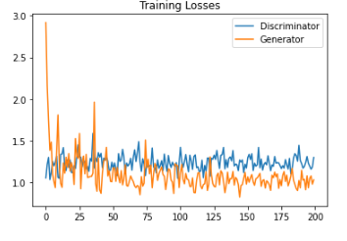
RESULTS
Demo Link
3/21/2024 Annual Review
10

